Slide 1
Programação Orientada a Desempenho (com .NET)
Fabio Galuppo

Slide 2
Agenda
Medir
Aprender
Refletir
Programar

Slide 3
Medir
Measure Early and Measure Often
“The next step in high-performance design is to measure—before writing a line of code, you need to know whether your performance goals are even possible, and if so, what constraints they place on the design. In my case, I need to know the costs of basic operations being considered in my design, such as raw file I/O and database access. To proceed, I need some numbers. This is the most critical time in the design of the project.
Sadly, most performance is lost very early in the development process. By the time you have chosen the data structures for the heart of your program, the application's performance profile has been set in stone. Choosing your algorithms further limits performance. Selecting interface contracts between various sub-components constrains performance still further. It is critical that you understand the costs of each of these early design decisions and make wise ones.
Design is an iterative process. It is best to start with the cleanest, simplest, most obvious choice and work up a sketch of the design (I actually recommend a prototype of the hot code) and evaluate the performance of that. You should also think about what the design would look like if you were to make performance the only factor, and then estimate how fast that application would be. Now the fun engineering begins! You start tinkering with the design and thinking about alternatives between these two extremes, looking for designs that give you the best result.”
https://docs.microsoft.com/en-us/archive/msdn-magazine/2008/april/clr-inside-out-measure-early-and-often-for-performance-part-1 Vance Morrison – April 2008

Slide 4
Medir
Ferramentas para .NET
System.Diagnostics.Stopwatch
HdrHistogram
https://github.com/HdrHistogram/HdrHistogram.NET
BenchmarkDotNet
https://github.com/dotnet/BenchmarkDotNet
Perfview
https://github.com/microsoft/perfview
GCRealTimeMon
https://github.com/Maoni0/realmon

Slide 5
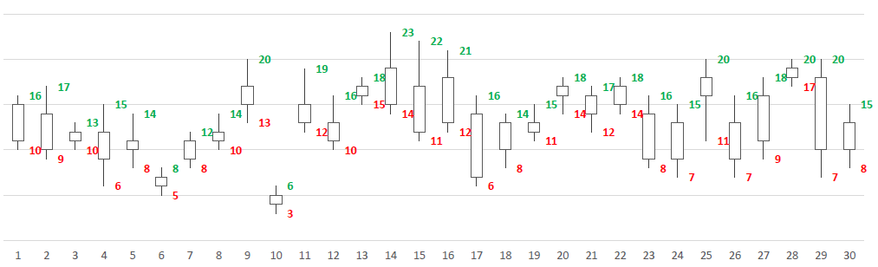
Aprender
Problema
Imagine que você recebeu uma tarefa para escrever um programa genérico que determine o lucro máximo num dado período de tempo, por exemplo o período de 30 dias indicado na figura.
Duas regras básicas:
1) você não pode comprar e vender no mesmo dia;
2) antes de vender é necessário comprar.
Para calcular o lucro, dois vetores são disponibilizados, um contendo os maiores valores e outro com os menores, H e L respectivamente. Ambos indexados pelos dias. A função objetivo do problema recebe como parâmetro estes vetores e deve retornar o lucro máximo. Isto é um problemade maximização.
https://github.com/fabiogaluppo/samples/blob/master/articles/DSN%20News%20-%20Ed%2001%20-%20Nov%202016%20-%20algoritmos.pdf
Fabio (Razzo) Galuppo - Uma breve introdução sobre algoritmo e eficiência - 2016

Slide 6
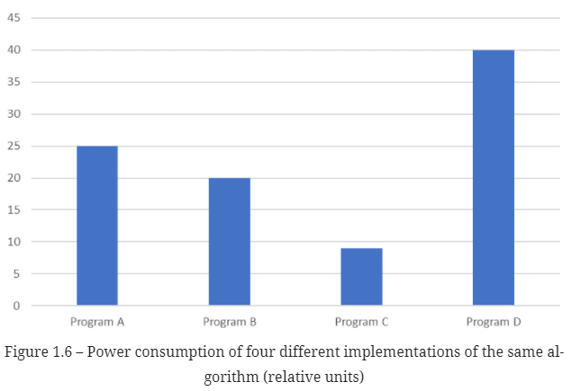
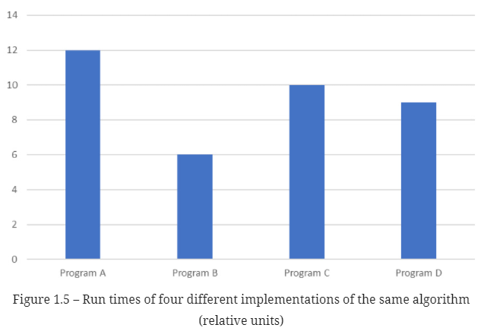
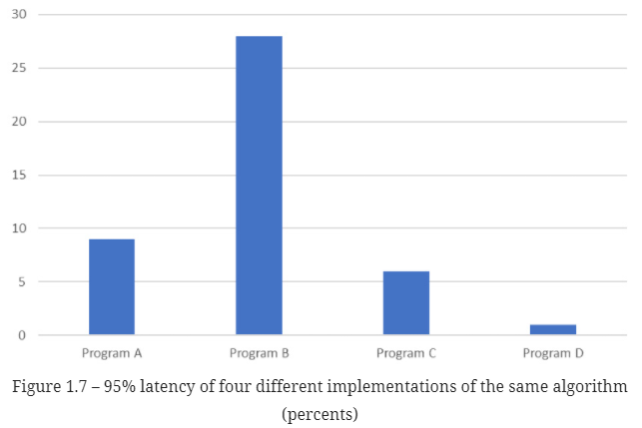
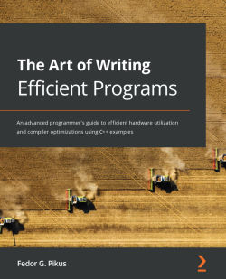
Refletir
Qual a melhor opção?
A, B, C ou D?
https://www.packtpub.com/product/the-art-of-writing-efficient-programs/9781800208117
Fedor G. Pikus - The Art of Writing Efficient Programs - 2021

Slide 7
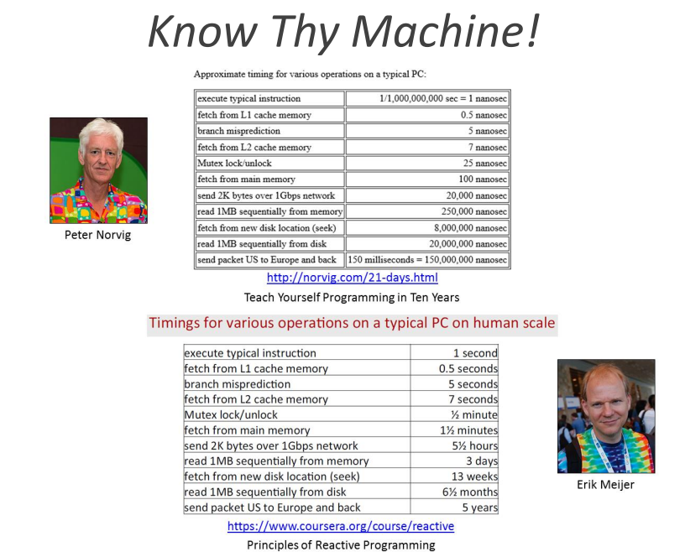
Refletir
https://norvig.com/21-days.html
Teach Yourself Programming in Ten Years - Peter Norvig - 1998

Slide 8

Ler
Code Reading
“We' re programmers. Our job (and in many cases our passion) is to make things happen by writing code. We don't meet our user's requirements with acres of diagrams, with detailed project schedules, with four-foot-high piles of design documentation. These are all wishes — expressions of what we'd like to be true. No, we deliver by writing code: code is reality. So that's what we're taught. Seems reasonable. Our job is to write code, so we need to learn how to write code. College courses teach us to to write programs. Training courses tell us how to code to new libraries and APIs. And that's one of the biggest tragedies in the industry.
Because the way to learn to write great code is by reading code. Lots of code. High-quality code, low-quality code. Code in assembler, code in Haskell. Code written by strangers ten thousand miles away, and code written by ourselves last week. Because unless we do that, we're continually reinventing what has already been done, repeating both the successes and mistakes of the past.”
https://www.spinellis.gr/codereading/
Diomidis Spinellis - Code Reading: The Open Source Perspective - 2003

Slide 9
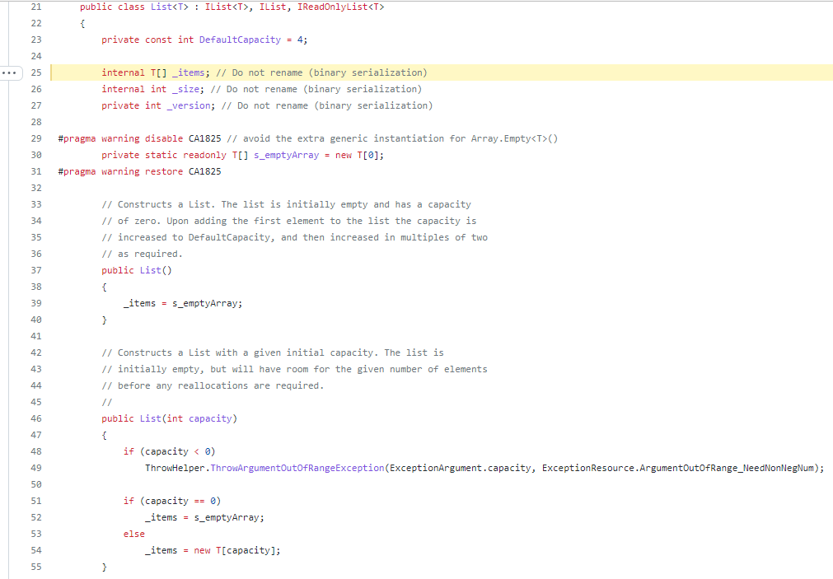
Ler
https://github.com/dotnet/runtime/blob/main/src/libraries/System.Private.CoreLib/src/System/Collections/Generic/List.cs#L25
System.Collections.Generic.List<T>

Slide 10
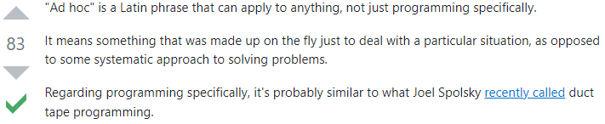
Programar
Ad-hoc Programming
https://stackoverflow.com/questions/1786735/what-does-ad-hoc-mean-in-programming
Algorithmic approach
Resolver o problema em termos de algoritmos e estrutura de dados
Mechanical Sympathy
"You don't have to be an engineer to be a racing driver, but you do have to have Mechanical Sympathy." - Jackie Stewart, racing driver

Slide 11
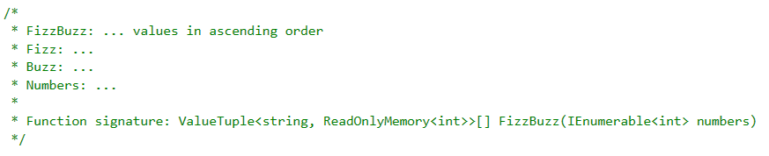
Programar
Problema
FizzBuzz
Versão Clustering
Entrada 1 a 100
Resultado:

Slide 12
Programar
Algorithmic approach
Abordagem Sequencial
Abordagem Paralela
Embarrassingly parallel
Partition
Sort
Partition
Sort
Partition
Sort
Partition
Sort
Partition
Sort
Partition
Sort
Partition
Sort
Partition
Sort

Slide 13
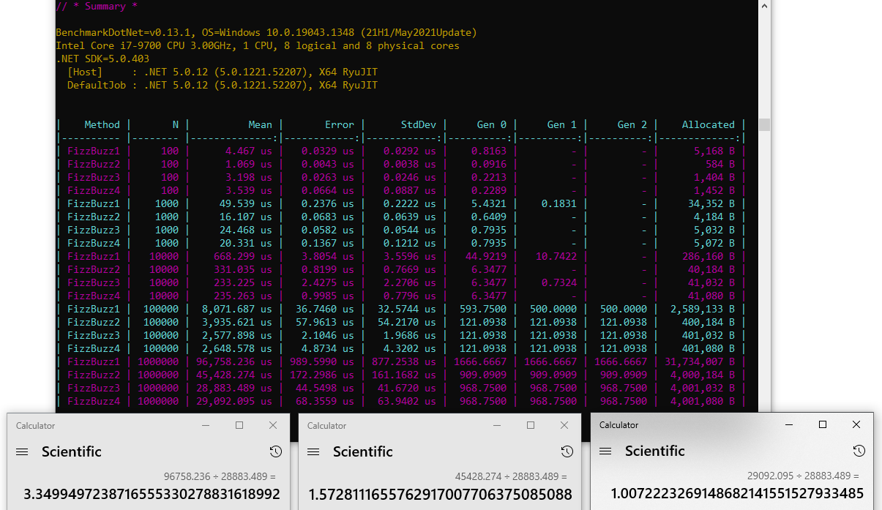
Medir, Aprender, Refletir, Programar

Slide 14
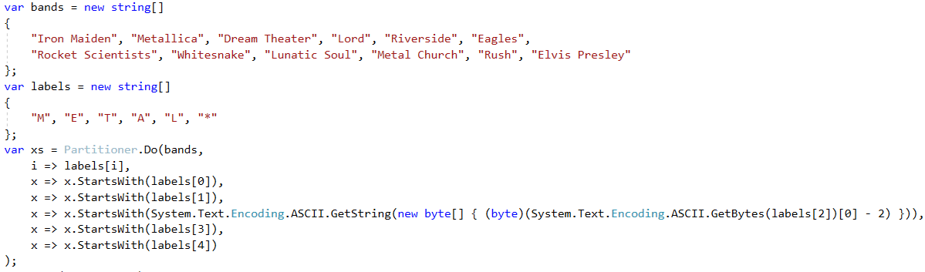
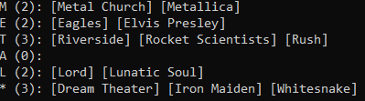
Medir, Aprender, Refletir, Programar
From Concrete to Generic

